Slide 1
EMPLOYEE DATA ANALYSIS USING EXCEL
STUDENT NAME: S.SHARMI
REGISTER NO: 312208422(asunm1330312208422)
DEPARTMENT: B.COM ACCOUNTING & FINANCE
COLLEGE: CHELLAMMAL WOMEN’S COLLEGE

Slide 2


PROJECT TITLE
Employee performance analysis using excel

Slide 3

AGENDA
Problem statement
Project overview
End users
Our solution and proposition
Dataset description
Modelling approach
Results and discussion
Conclusion

Slide 4


PROBLEM STATEMENT
TO IDENTIFY ROOT CAUSES OF PERFORMANCE DECLINE
TO IMPLEMENT IMPROVEMENT STRATEGIS
TO MONITOR AND EVALUVATE PROGRESS
TO ENHANCE EMPLOYEE TRAINING PROGRAMMES TO ADDRESS SKILL GAPS
TO IMPROVE MANAGEMENT PRACTICS TO FOSTER A SUPPOTIVE WORK ENVIRONMENT
TO INCREASE EMPLOYEE MOTIVATION THROUGH RECOGNITION AND REWARD SYSTEM
TO IMPLEMENT TECHNOLOGY SOLUTION TO STREAM LINE WORK FLOWS
CONDECT REGULAR FEEDBACK SESSION TO CONTINUOUSLY IMPROVE PERFOMANCE

Slide 5
PROJECT OVERVIEWS
EMPLOYEE PERFORMANCE ANALYSIS
ANALYSING THE PERFORMANCE OF THE EMPLOYEE BY CONSIDRING VARIOUS FACTORS LIKE GENDER PERFORMANCE CODE RATING AND THEIR ACHEIVEMENTS IN ORDER TO IDENTIFY TRENDS AND PATTENS OF DIFRENT CATOGIRIES OF EMPLOYEES LIKE HIGH,MEDIUM AND LOW
OBJECTIVES
TO ENHANCE EMPLOYEE PERFORMANCE BY IDENTIFYING AND ADDRESSING KEY FACTORS AFFECTING PRODUCTIVITY QUALITY OF WORK AND ENGAGEMENT
SCOPE
COLLECT AND ANALYSIS DATA FROM PERFORMANCE REVIEWS SURVEYS AND INTERVIEWS TO IDENTIFING ROOT CAUSES OF PERFORMANCE ISSUES IMPLEMENT IMPROVEMENT STRATEGIES AND MONITORS THEIR EFFECTIVENESS

Slide 6

WHO ARE THE END USERS?
BOARD OF DIRECTORS
MANAGEMENT AND LEARDSHIP
HUMAN RESOURCES (HR)
EMPLOYEE TEAM LEADERS AND SUPERVISORS
TRAINING AND DEVELOPMENT
EXECUTIVES
PROJECT MANAGER
FINANCE DEPARTMENT
IT DEPARTMENT
OPERATIONS MANAGERS
SALES AND MARKETING TEAMS

Slide 7
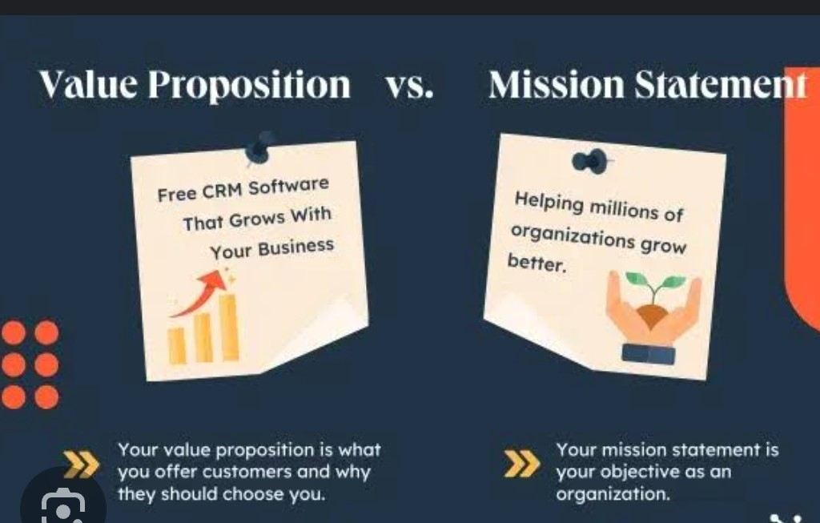

SOLUTION AND ITS VALUE PROPOSITION
CONDITIONAL FORMATTING = MISSING
FILTER = REMOVE
FORMULA = PERFORMANCE
PIVOT TABLE = SUMMARY
GRAPH = DATA VISUALIZATION

Slide 8


DATASET DESCRIPTION
EMPLOYEE DATASET - KAGGLE
26 FEATURES AVAILABLE – 9 FEATURES USED
EMPLOYEE ID – NUMERICAL
EMPLOYEE NAME – TEXT
EMPLOYEE TYPE – ROLES
PEFRORMANCE LEVEL – HIGH, MEDIUM AND LOW
GENDER – MALE AND FEMALE
EMPLOYEE RATING – NUMERICAL

Slide 9

THE “WOW” IN OUR SOLUTION
CONDITIONAL FORMATTING
IDENTIFING MISSING DATA.
FILTER
TO REMOVE BLANK CELLS.
PERFORMANCE LEVEL
IFS (logical_ test 1,[logical_test2,value_if_true2],…)
IFS(Z8>=5,”VERY HIGH”,Z8>=3,MEDIUM”,TRUE,’’LOW)
SUMMARY
PIVOT TABLE
DATA VIZUALIZATION
GHRAPH : COLUMN CHART WITH TREND LINE

Slide 10

MODELLING
DATA COLLECTION
FEATURE COLLECTION
DATA CLEANING
PERFORMANCE LEVEL
SUMMARY
VISUALIZATION

Slide 11

DATA COLLECTION 1. DATA FROM KAGGLE 2. DATA SELECTION
SUMMARY
PIVOT TABLE
RESULT EMPLOYEE PERFORRMANCE LEVEL
DATA CLEANING
1. IDENTIFYIYING MISSING
2. FILTEROUT MISSING VALUE
FEATURES COLLECTION
FEATURES IDENTIFICATION
CONDITIONAL FORMATING
DATA VISUALIZATION
1. GRAPH
2. COLUMN CHART

Slide 12
RESULT EMPLOYEE PERFORMANCE ANALYSIS

Slide 13
CONCLUSION
THE BAR CHART AND PIE CHART PROVIDEED COMPLEMENTERY INSIGHTS INTO EMPLOYEE PERFORMANCE ACROSS DIFFERENT CATEGORIES. THE BAR CHART OFFERS A DETAILS COMPARISION SHOWING PERFORMANCE LEVELS SUCH AS LOW AND HIGH AND MEDIUM ACROSS THE CATEGORIES LIKES SVC, INC, INS,AND WBL THIS ALLOWS THE COMPANY SUCHA AS HIGH MEDIAN MODLE THESE CHART ENABLE THE APPROACH IMPROVEMENT LIKE COMPNY MODEL

